Slide 1
Summer Internship Program LoRaWAN Temperature Sensors for the City of Melville
Jack Downes
February 2018
Notes:
-I’ve developed a tool to effectively capture heat data for the City of Melville.
..relationship between local government and mapping heat.

Slide 2
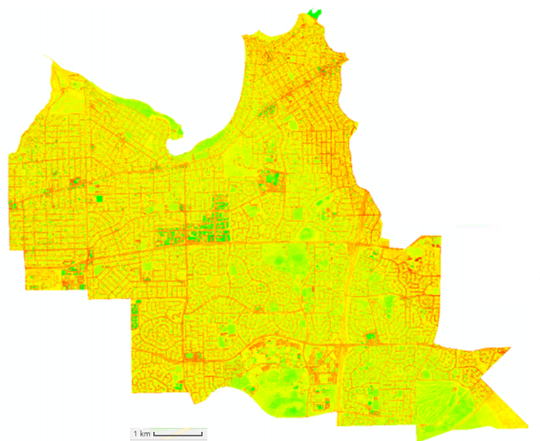
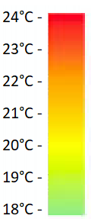
Heat Islands & Urban Forests
Heat Islands retain heat shown in red
Urban Forests act to cool urban environments by shading areas and absorbing less heat
Thermal imagery shows this well but it lacks granularity
(Dave Schupp)
Notes:
-explain HI and UF
-diagram context
….broad snapshot
…material specific design decisions.

Slide 3
Problem overview
How far apart should trees be planted?
What types of Asphalt dissipate heat fasted?
Can the colour of roofs in the area have an affect the amount of heat it retains?
Does a row of trees running East West become more affective than one running North South?
Notes:
…At the moment these questions are answered using limited and costly thermal imagery, manual labour or simply best judgement.
…make evidence based choices, by supplying them with granular, time sensitive data.

Slide 4
The Requirements
Data
Flexibility
Cost
Notes:
- localised and accountable
- fraction of the price of thermal imagery
- scale and adapt

Slide 5
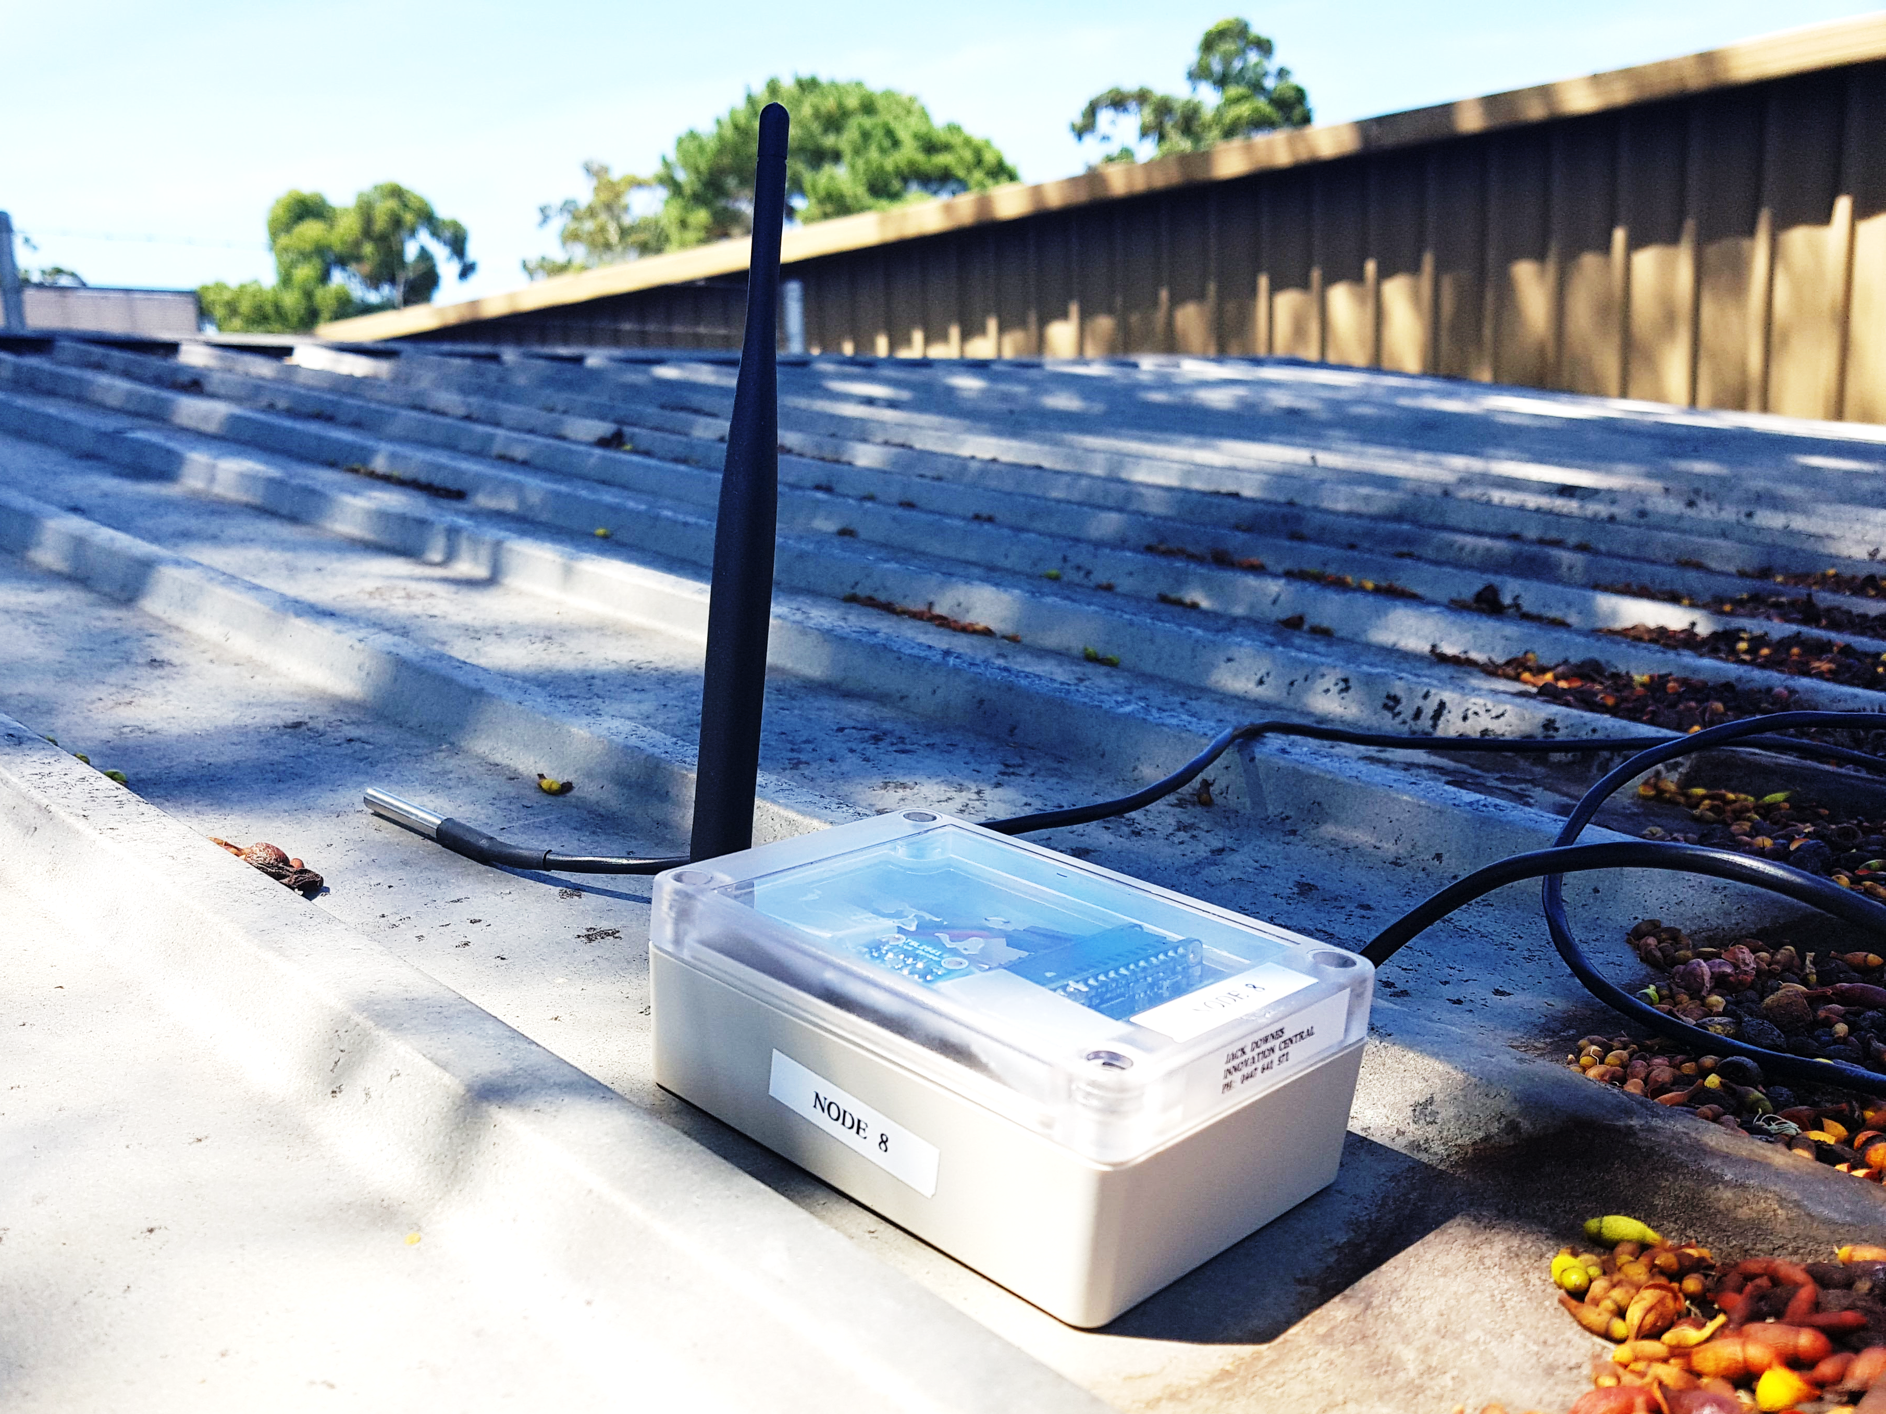
Solution
LoRaWAN Enabled Sensor Array
Featuring:
Short recording intervals
Long Battery life
Extensive network range
Precision location
Notes:
LoRaWAN enabled battery powered sensor array.
Boasting
-recording intervals
-battery life
-network range
-Get only the data you need
-sharp good looks
elegant solution to an array of questions.

Slide 6
The System
Sensor Array
LoRaWAN Network
Data Storage
Data visualisation
Notes:
The beauty of this solution compared to others is it’s low cost, versatility and scalability.
Includes: Light and temp sensors
Can be added: moisture levels, humidity, location
3 sensors -> can be expanded
their data being stored in the same location and pulled together to be visualised in what ever manner makes the most sense.

Slide 7
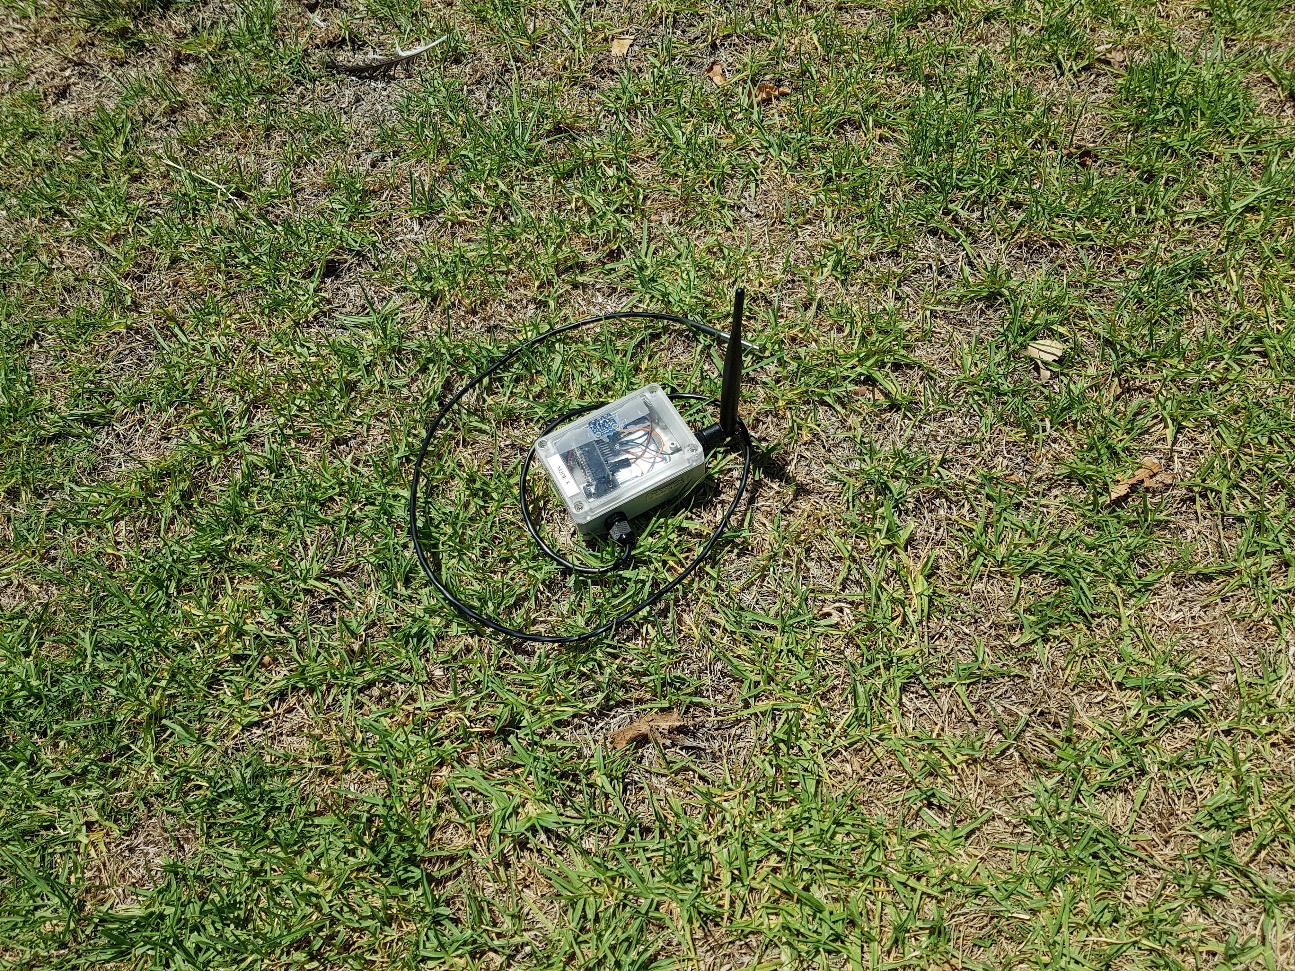
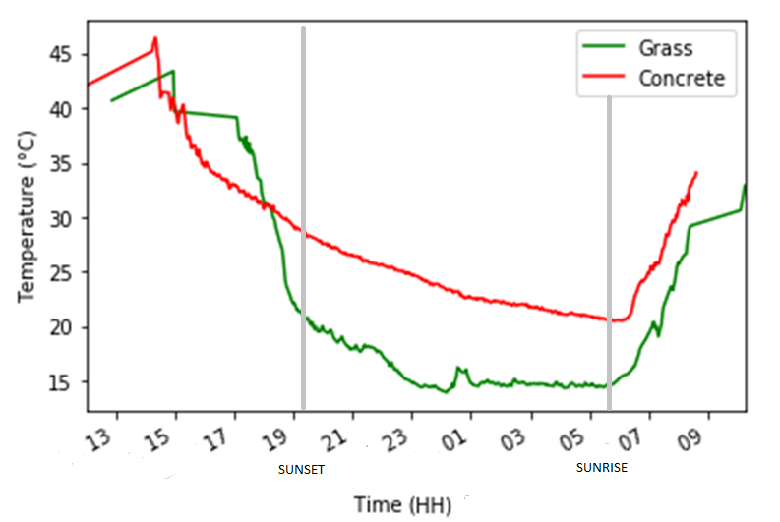
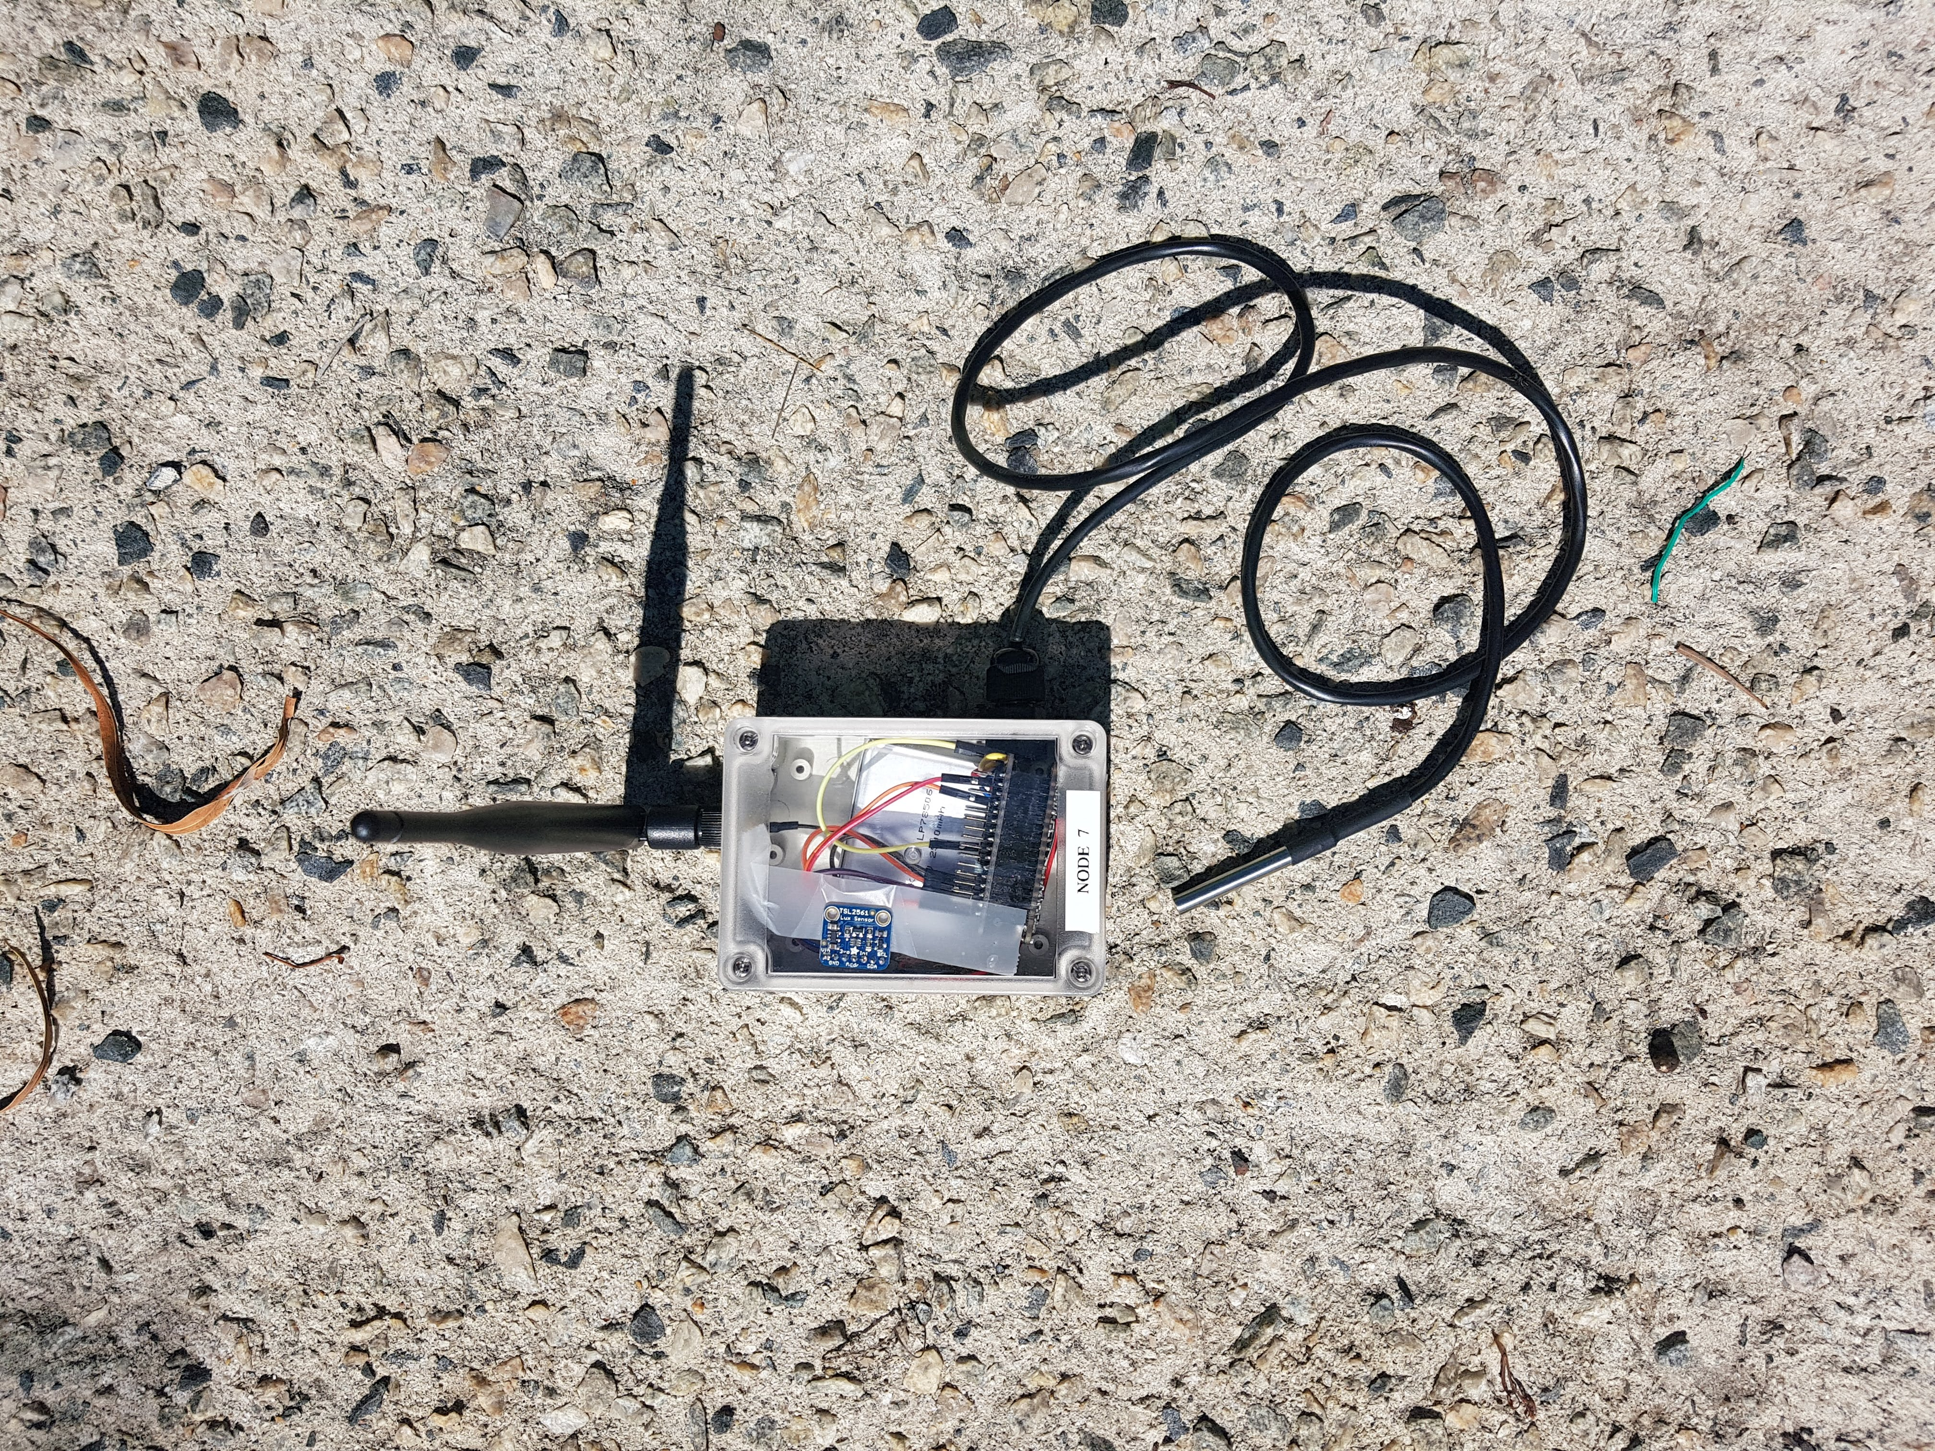
Overnight Heat Dissipation
Notes:
-deployed 2 sensors
During daylight hours concrete and grass sit at a similar temperature, but as darkness falls the grass rapidly drops to below 20 degrees while the concrete dissipates heat much slower.
From this we can intuitively understand the differences in Heat Islands and Urban Forests.

Slide 8
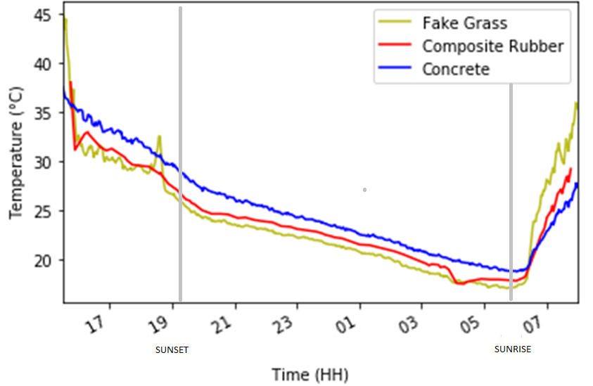
Playground Materials
Notes:
-materials found in a play ground
-interesting points.
-direct insight -> identify trouble materials -> cooler choices.

Slide 9
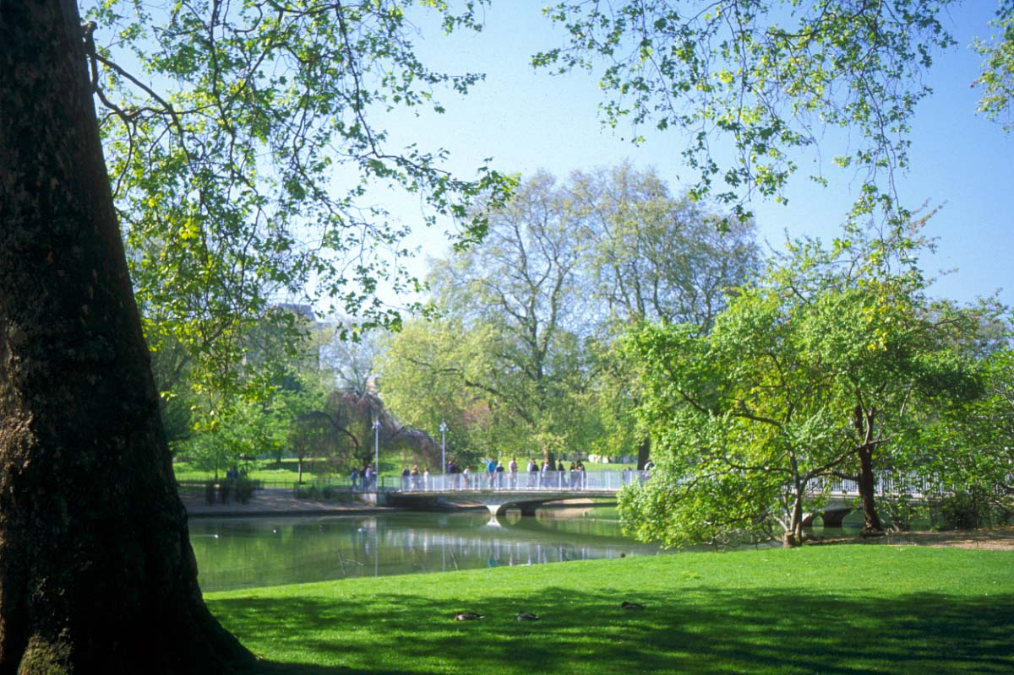
Outcomes
Sensors can be used in conjunction with thermal imagery to conduct more rigorous research
Unit cost can be brought down with scale
Future studies can go on to collect larger data sets over the course of a year
Workflow can be adapted to suit a much faster learning curve
This Photo by Unknown Author is licensed under CC BY-NC-ND
Notes:
In conclusion
I see this technology as a viable tool for studies into local climate control for the City of Melville.
With a growing public interest in our climate, I hope a sensor network of this type can take the guess work out of making our urban environments a cooler more inviting place to inhabit.

Slide 10

Thanks to: Janine Ahola, David Belton, Tom De Ruijter, Kevin Glasson, Petra Helmholz, Nathan Jombwe, Iman Kareem, Bradley Schupp
10
Notes:
In conclusion
I see this technology as a viable tool for studies into local climate control for the City of Melville.
With a growing public interest in our climate, I hope a sensor network of this type can take the guess work out of making our urban environments a cooler more inviting place to inhabit.

